Slide 1
Student name: amin Kamranfar Project: Iris Flower
Link to github:
https://github.com/tyrex1368/amin1368

Slide 2
Iris flower project
It was introduced by Fisher in 1936
It is an example of linear discriminant analysis
Morphologic variation of iris flower
We have three related species
Iris is one of the first for multivariate data analysis

Slide 3
Data set
50 sample from each of three species of iris
Iris versicolor, iris virginica, iris setosa
The length and width of sepals and petals have been measured
Developing a linear discriminant model to detect the species from each model

Slide 4
Download dataset
Data Set Characteristics: | Multivariate | Number of Instances: | 150 | Area: | Life
Attribute Characteristics: | Real | Number of Attributes: | 4 | Date Donated | 1988-07-01
Associated Tasks: | Classification | Missing Values? | No | Number of Web Hits: | 3840496

Slide 5
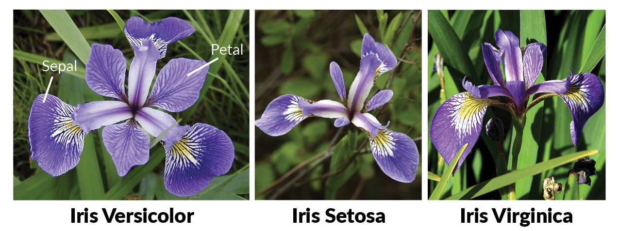
Types of Iris Flower

Slide 6
Analyzing data set
1. sepal length in cm 2. sepal width in cm 3. petal length in cm 4. petal width in cm 5. class: -- Iris Setosa -- Iris Versicolour -- Iris Virginica

Slide 7
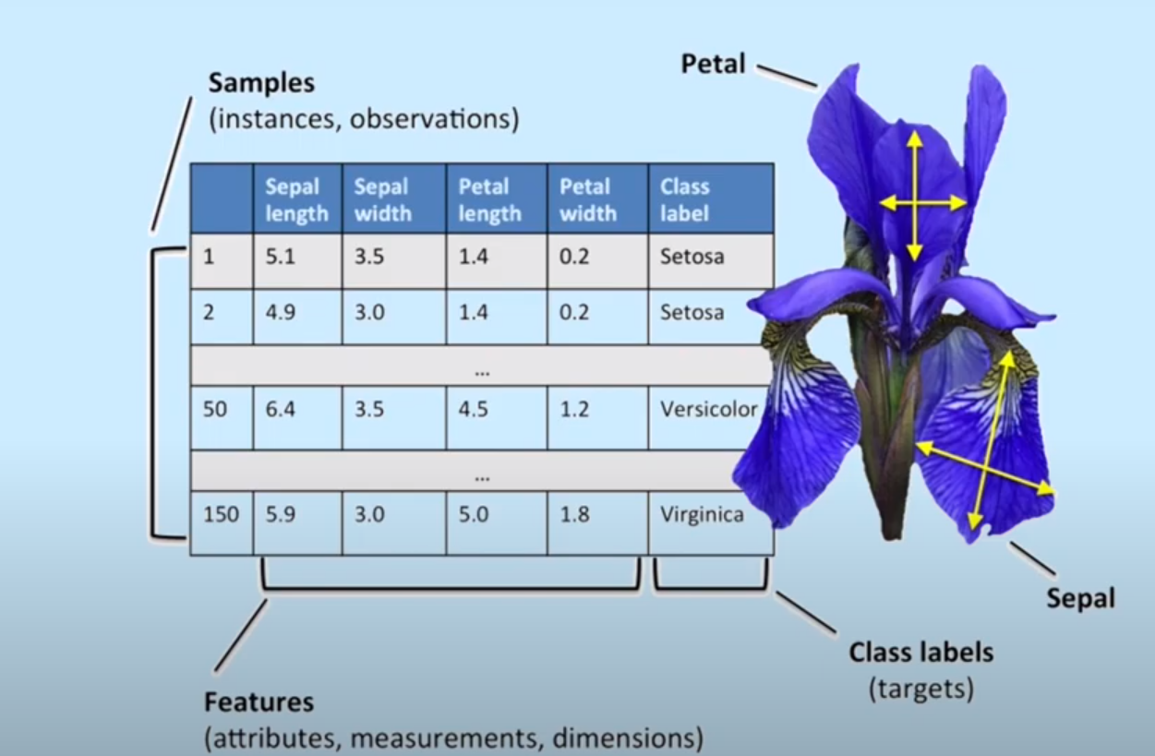
Dataset Structure

Slide 8
Technologies
We can analyze data in four different aspect:
Data Visualization
Data analytics
Data Mining
Data storage
Each of these aspect of data have their own software-utility. For the project the dataset is included in R base and Python in the machine learning package Scikit-learn.

Slide 9
Dataset Exploration
## 'data.frame': 150 obs. of 5 variables:
## $ Sepal.Length: num 5.1 4.9 4.7 4.6 5 5.4 4.6 5 4.4 4.9 ...
## $ Sepal.Width : num 3.5 3 3.2 3.1 3.6 3.9 3.4 3.4 2.9 3.1 ...
## $ Petal.Length: num 1.4 1.4 1.3 1.5 1.4 1.7 1.4 1.5 1.4 1.5 ...
## $ Petal.Width : num 0.2 0.2 0.2 0.2 0.2 0.4 0.3 0.2 0.2 0.1 ...
## $ Species : Factor w/ 3 levels "setosa","versicolor",..: 1 1 1 1 1 1 1 1 1 1 ...

Slide 10
Goal
The aim is to classify iris flowers among three species (setosa, versicolor, or virginica) from measurements of sepals and petals' length and width.
Linear regression cases
Logistic regression algorithms

